Slide 1
Deep Learning Overview

Slide 2
Lecture Outline
Machine learning basics
Supervised and unsupervised learning
Linear and non-linear classification methods
Introduction to deep learning
Elements of neural networks (NNs)
Activation functions
Training NNs
Gradient descent
Regularization methods
NN architectures
Convolutional NNs
Recurrent NNs

Slide 3
Machine Learning Basics
Machine Learning Basics
Artificial Intelligence is a scientific field concerned with the development of algorithms that allow computers to learn without being explicitly programmed
Machine Learning is a branch of Artificial Intelligence, which focuses on methods that learn from data and make predictions on unseen data
Labeled Data
Machine Learning algorithm
Training
Prediction
Labeled Data
Learned model
Prediction
Picture from: Ismini Lourentzou – Introduction to Deep Learning

Slide 4

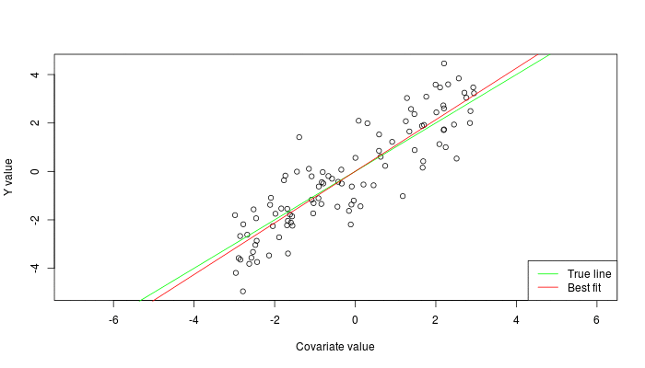

Machine Learning Types
Machine Learning Basics
Supervised: learning with labeled data
Example: email classification, image classification
Example: regression for predicting real-valued outputs
Unsupervised: discover patterns in unlabeled data
Example: cluster similar data points
Reinforcement learning: learn to act based on feedback/reward
Example: learn to play Go
class A
class B
Classification
Regression
Clustering
Slide credit: Ismini Lourentzou – Introduction to Deep Learning

Slide 5
Supervised Learning
Machine Learning Basics
Supervised learning categories and techniques
Numerical classifier functions
Linear classifier, perceptron, logistic regression, support vector machines (SVM), neural networks
Parametric (probabilistic) functions
Naïve Bayes, Gaussian discriminant analysis (GDA), hidden Markov models (HMM), probabilistic graphical models
Non-parametric (instance-based) functions
k-nearest neighbors, kernel regression, kernel density estimation, local regression
Symbolic functions
Decision trees, classification and regression trees (CART)
Aggregation (ensemble) learning
Bagging, boosting (Adaboost), random forest
Slide credit: Y-Fan Chang – An Overview of Machine Learning

Slide 6
Unsupervised Learning
Machine Learning Basics
Unsupervised learning categories and techniques
Clustering
k-means clustering
Mean-shift clustering
Spectral clustering
Density estimation
Gaussian mixture model (GMM)
Graphical models
Dimensionality reduction
Principal component analysis (PCA)
Factor analysis
Slide credit: Y-Fan Chang – An Overview of Machine Learning

Slide 7
Nearest Neighbor Classifier
Machine Learning Basics
Nearest Neighbor – for each test data point, assign the class label of the nearest training data point
Adopt a distance function to find the nearest neighbor
Calculate the distance to each data point in the training set, and assign the class of the nearest data point (minimum distance)
It does not require learning a set of weights
Test example
Training examples from class 2
Training examples from class 1
Picture from: James Hays – Machine Learning Overview

Slide 8
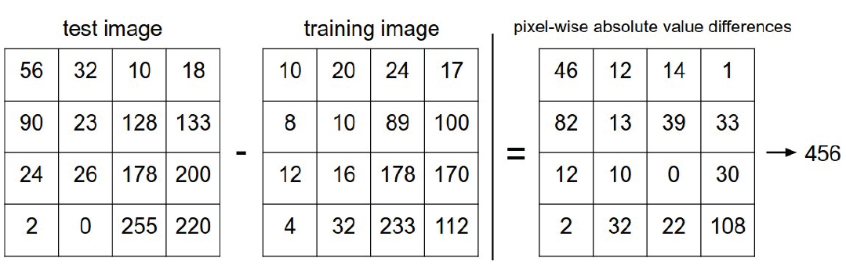
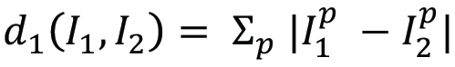
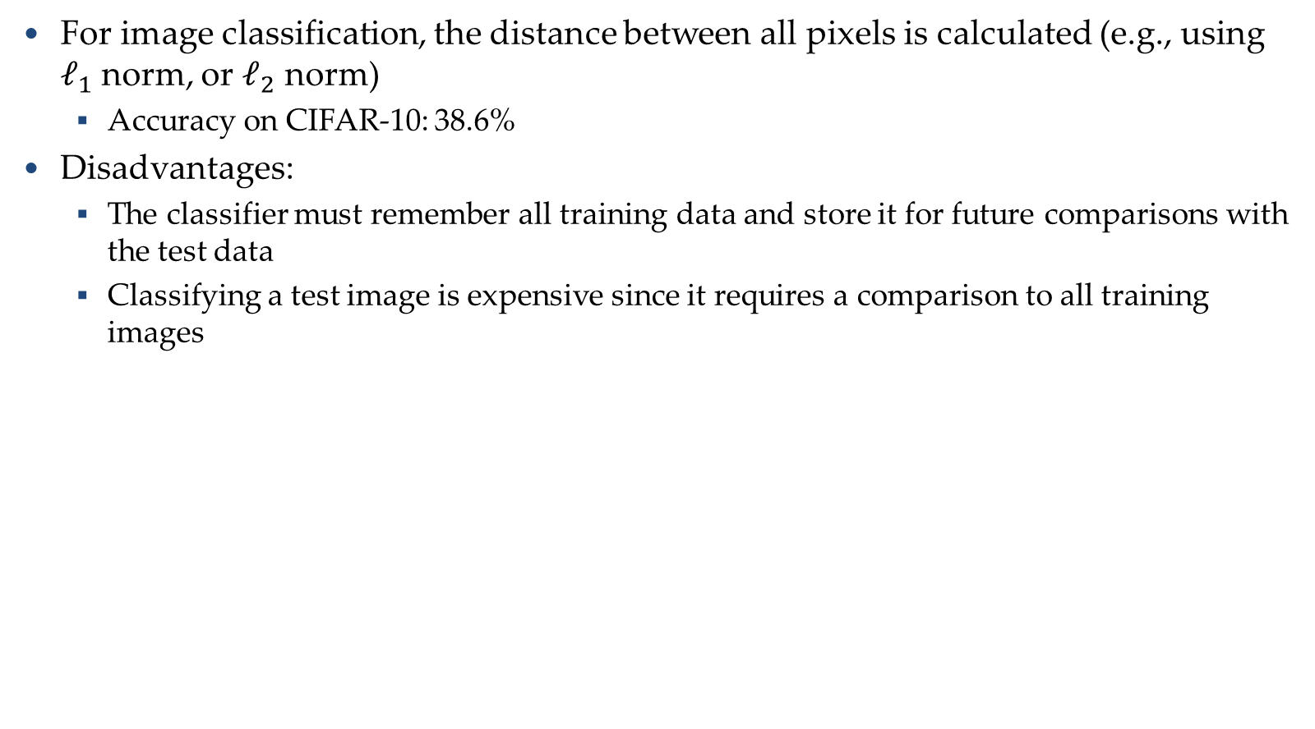
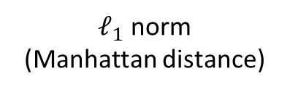
Nearest Neighbor Classifier
Machine Learning Basics
For image classification, the distance between all pixels is calculated (e.g., using $ℓ_{1}$ norm, or $ℓ_{2}$ norm)
Accuracy on CIFAR-10: 38.6%
Disadvantages:
The classifier must remember all training data and store it for future comparisons with the test data
Classifying a test image is expensive since it requires a comparison to all training images
$ℓ_{1}$ norm
(Manhattan distance)
Picture from: https://cs231n.github.io/classification/

Slide 9
k-Nearest Neighbors Classifier
Machine Learning Basics
k-Nearest Neighbors approach considers multiple neighboring data points to classify a test data point
E.g., 3-nearest neighbors
The test example in the figure is the + mark
The class of the test example is obtained by voting (based on the distance to the 3 closest points)
x2
x
x
x
o
x
x
x
x
+
o
x
o
o
x
o
+
o
o
o
o
x1
Picture from: James Hays – Machine Learning Overview

Slide 10
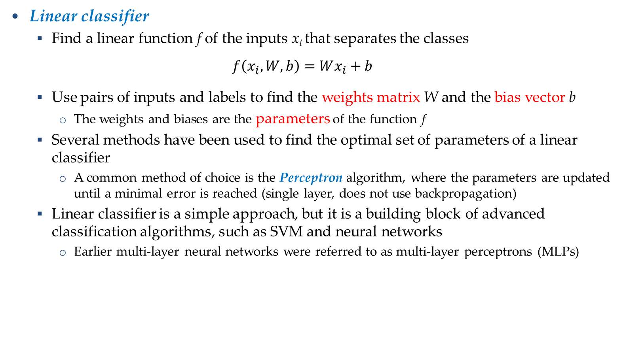
Linear Classifier
Machine Learning Basics
Linear classifier
Find a linear function f of the inputs x_{i} that separates the classes
$$f\left(x_{i},W,b\right)=Wx_{i}+b$$
Use pairs of inputs and labels to find the weights matrix W and the bias vector b
The weights and biases are the parameters of the function f
Several methods have been used to find the optimal set of parameters of a linear classifier
A common method of choice is the Perceptron algorithm, where the parameters are updated until a minimal error is reached (single layer, does not use backpropagation)
Linear classifier is a simple approach, but it is a building block of advanced classification algorithms, such as SVM and neural networks
Earlier multi-layer neural networks were referred to as multi-layer perceptrons (MLPs)

Slide 11
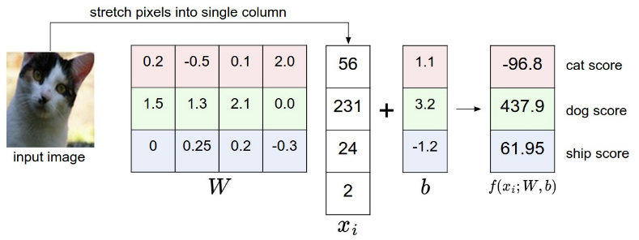
Linear Classifier
Machine Learning Basics
The decision boundary is linear
A straight line in 2D, a flat plane in 3D, a hyperplane in 3D and higher dimensional space
Example: classify an input image
The selected parameters in this example are not good, because the predicted cat score is low
Picture from: https://cs231n.github.io/classification/

Slide 12
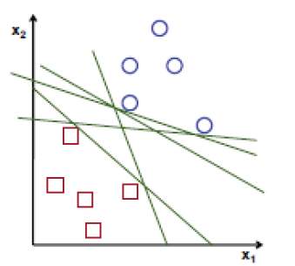
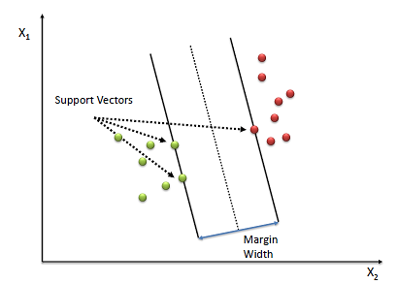
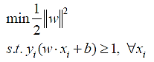
Support Vector Machines
Machine Learning Basics
Support vector machines (SVM)
How to find the best decision boundary?
All lines in the figure correctly separate the 2 classes
The line that is farthest from all training examples will have better generalization capabilities
SVM solves an optimization problem:
First, identify a decision boundary that correctly classifies the examples
Next, increase the geometric margin between the boundary and all examples
The data points that define the maximum margin width are called support vectors
Find W and b by solving:

Slide 13
Linear vs Non-linear Techniques
Linear vs Non-linear Techniques
Linear classification techniques
Linear classifier
Perceptron
Logistic regression
Linear SVM
Naïve Bayes
Non-linear classification techniques
k-nearest neighbors
Non-linear SVM
Neural networks
Decision trees
Random forest

Slide 14
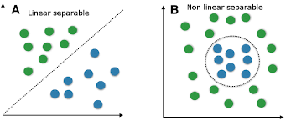
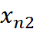
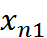
Linear vs Non-linear Techniques
Linear vs Non-linear Techniques
For some tasks, input data can be linearly separable, and linear classifiers can be suitably applied
For other tasks, linear classifiers may have difficulties to produce adequate decision boundaries
Picture from: Y-Fan Chang – An Overview of Machine Learning

Slide 15
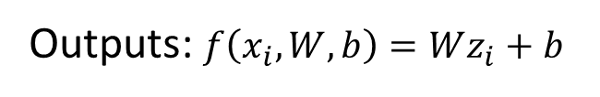
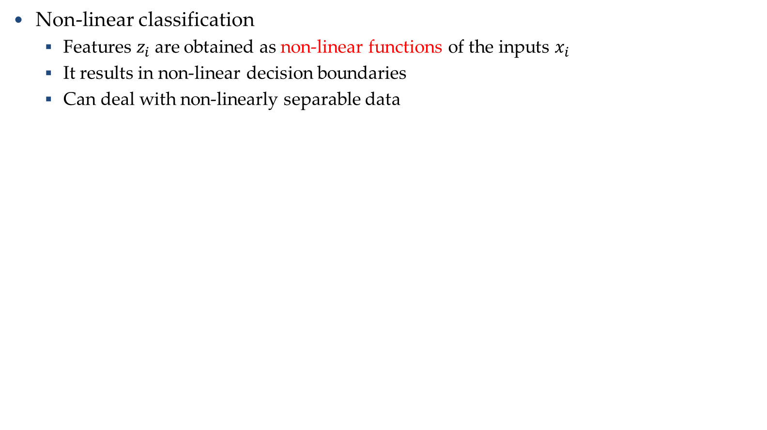
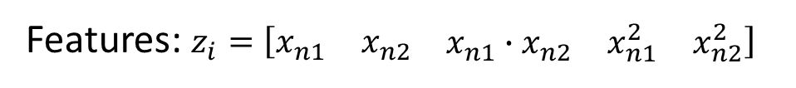
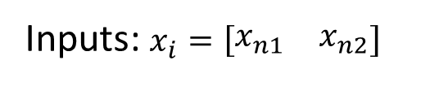
Non-linear Techniques
Linear vs Non-linear Techniques
Non-linear classification
Features $z_{i}$are obtained as non-linear functions of the inputs $x_{i}$
It results in non-linear decision boundaries
Can deal with non-linearly separable data
Inputs: $x_{i}=\left[\begin{matrix}x_{n1} & x_{n2}\end{matrix}\right]$
Features: $z_{i}=\left[\begin{matrix}x_{n1} & x_{n2} & \begin{matrix}x_{n1}∙x_{n2} & x_{n1}^{2} & x_{n2}^{2}\end{matrix}\end{matrix}\right]$
Outputs: $f\left(x_{i}, W, b\right)=Wz_{i}+b$
Picture from: Y-Fan Chang – An Overview of Machine Learning

Slide 16
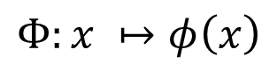
Non-linear Support Vector Machines
Linear vs Non-linear Techniques
Non-linear SVM
The original input space is mapped to a higher-dimensional feature space where the training set is linearly separable
Define a non-linear kernel function to calculate a non-linear decision boundary in the original feature space
$$Φ:x ↦φ\left(x\right)$$
Picture from: James Hays – Machine Learning Overview

Slide 17
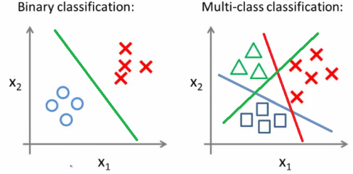
Binary vs Multi-class Classification
Binary vs Multi-class Classification
A classification problem with only 2 classes is referred to as binary classification
The output labels are 0 or 1
E.g., benign or malignant tumor, spam or no-spam email
A problem with 3 or more classes is referred to as multi-class classification

Slide 18
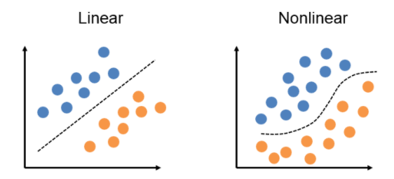
Binary vs Multi-class Classification
Binary vs Multi-class Classification
Both the binary and multi-class classification problems can be linearly or non-linearly separated
Figure: linearly and non-linearly separated data for binary classification problem

Slide 19
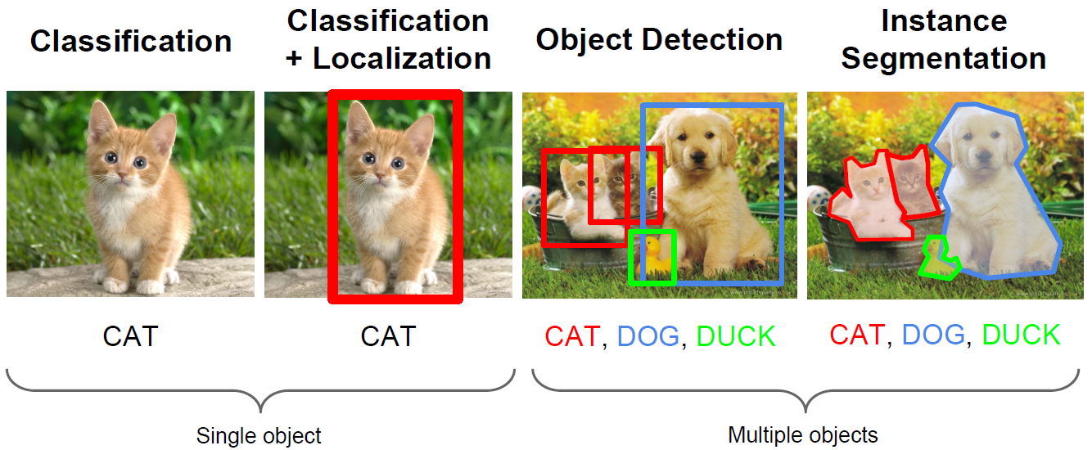
Computer Vision Tasks
Machine Learning Basics
Computer vision has been the primary area of interest for ML
The tasks include: classification, localization, object detection, instance segmentation
Picture from: Fie-Fei Li, Andrej Karpathy, Justin Johnson – Understanding and Visualizing CNNs

Slide 20
No-Free-Lunch Theorem
Machine Learning Basics
Wolpert (2002) - The Supervised Learning No-Free-Lunch Theorems
The derived classification models for supervised learning are simplifications of the reality
The simplifications are based on certain assumptions
The assumptions fail in some situations
E.g., due to inability to perfectly estimate ML model parameters from limited data
In summary, No-Free-Lunch Theorem states:
No single classifier works the best for all possible problems
Since we need to make assumptions to generalize

Slide 21
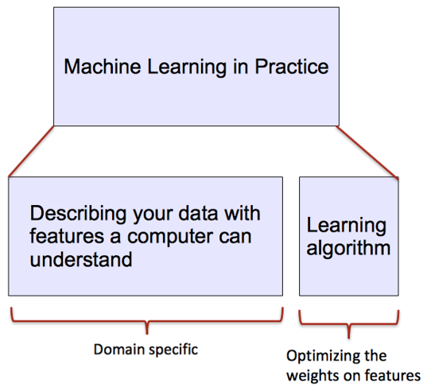
ML vs. Deep Learning
Introduction to Deep Learning
Conventional machine learning methods rely on human-designed feature representations
ML becomes just optimizing weights to best make a final prediction
Picture from: Ismini Lourentzou – Introduction to Deep Learning

Slide 22

ML vs. Deep Learning
Introduction to Deep Learning
Deep learning (DL) is a machine learning subfield that uses multiple layers for learning data representations
DL is exceptionally effective at learning patterns
Picture from: https://www.xenonstack.com/blog/static/public/uploads/media/machine-learning-vs-deep-learning.png

Slide 23

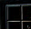
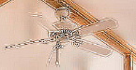
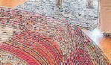
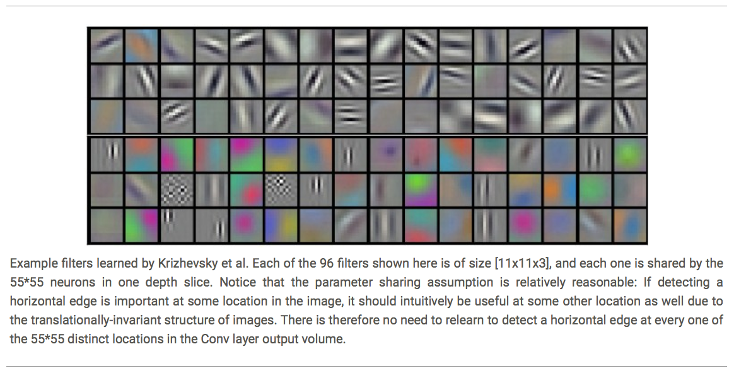
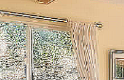



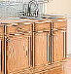






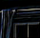

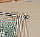
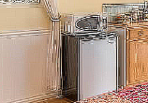
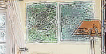
ML vs. Deep Learning
Introduction to Deep Learning
DL applies a multi-layer process for learning rich hierarchical features (i.e., data representations)
Input image pixels → Edges → Textures → Parts → Objects
Low-Level Features
Mid-Level Features
High-Level Features
Trainable Classifier
Output
Slide credit: Param Vir Singh – Deep Learning

Slide 24
Why is DL Useful?
Introduction to Deep Learning
DL provides a flexible, learnable framework for representing visual, text, linguistic information
Can learn in supervised and unsupervised manner
DL represents an effective end-to-end learning system
Requires large amounts of training data
Since about 2010, DL has outperformed other ML techniques
First in vision and speech, then NLP, and other applications

Slide 25
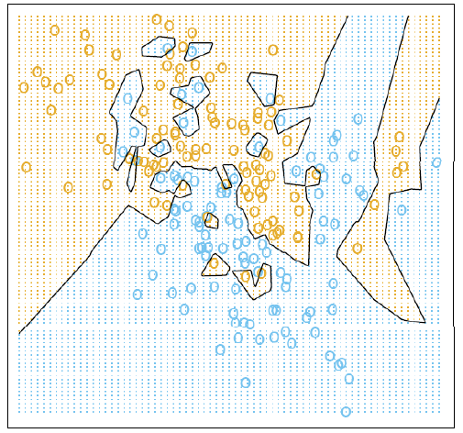
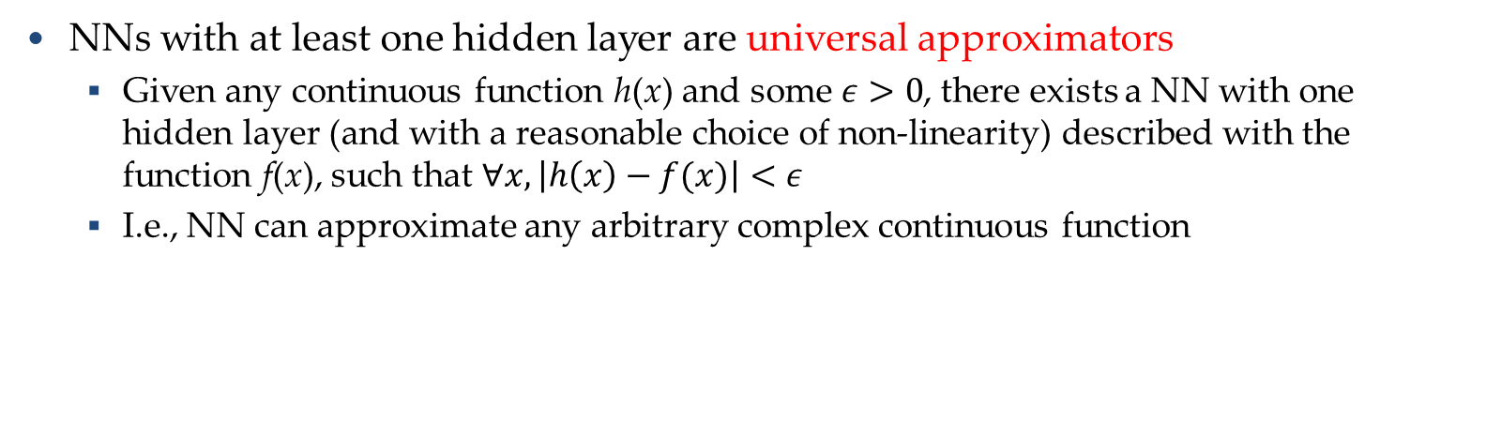
Representational Power
Introduction to Deep Learning
NNs with at least one hidden layer are universal approximators
Given any continuous function h(x) and some $ε>0$, there exists a NN with one hidden layer (and with a reasonable choice of non-linearity) described with the function f(x), such that $∀x, \left|h\left(x\right)−f(x)\right|<ε$
I.e., NN can approximate any arbitrary complex continuous function
NNs use nonlinear mapping of the inputs x to the outputs f(x) to compute complex decision boundaries
But then, why use deeper NNs?
The fact that deep NNs work better is an empirical observation
Mathematically, deep NNs have the same representational power as a one-layer NN

Slide 26
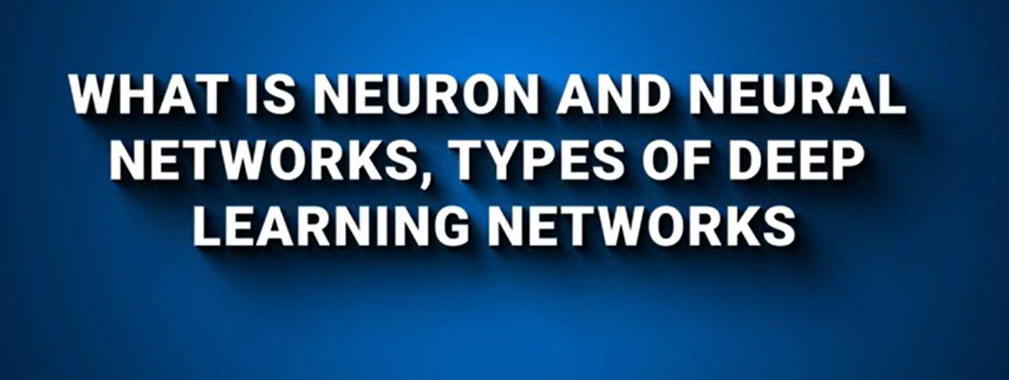

Slide 27

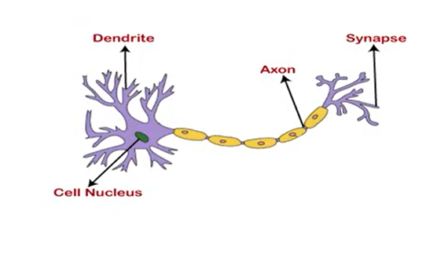
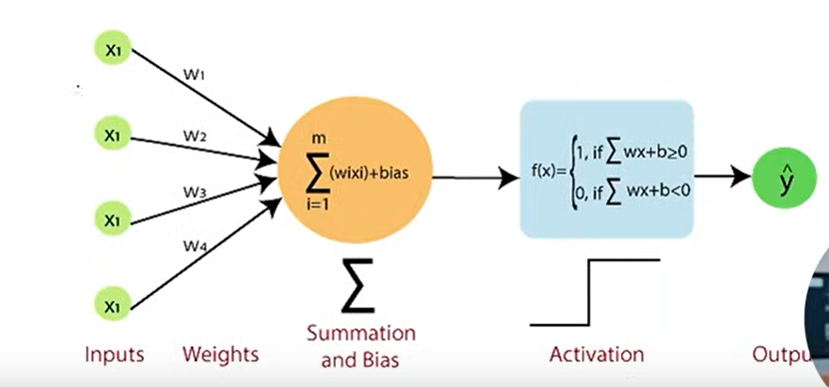

Slide 28

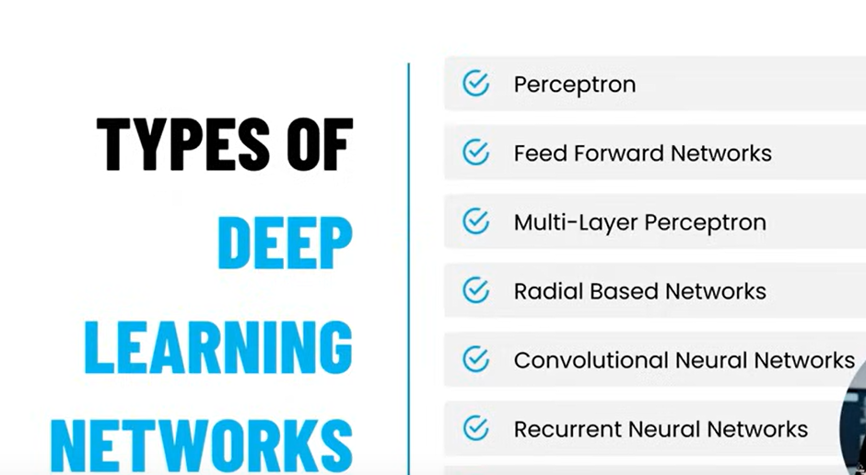

Slide 29

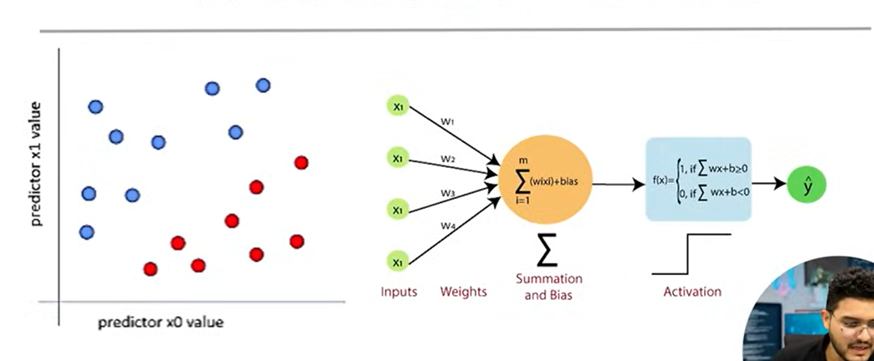

Slide 31
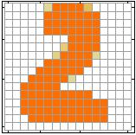
Introduction to Neural Networks
Introduction to Neural Networks
Handwritten digit recognition (MNIST dataset)
The intensity of each pixel is considered an input element
Output is the class of the digit
Input
Output
y₁
is 1
0.1
y₂
is 2
0.7
The image is “2”
……
……
……
y₁₀
0.2
is 0
16 x 16 = 256
Ink → 1
No ink → 0
Each dimension represents the confidence of a digit
Slide credit: Hung-yi Lee – Deep Learning Tutorial

Slide 32

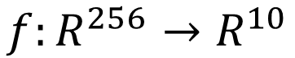
Introduction to Neural Networks
Introduction to Neural Networks
Handwritten digit recognition
y₁
Machine
y₂
“2”
……
……
$$f:R^{256}→R^{10}$$
y₁₀
The function $f$ is represented by a neural network
Slide credit: Hung-yi Lee – Deep Learning Tutorial

Slide 33
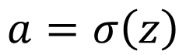
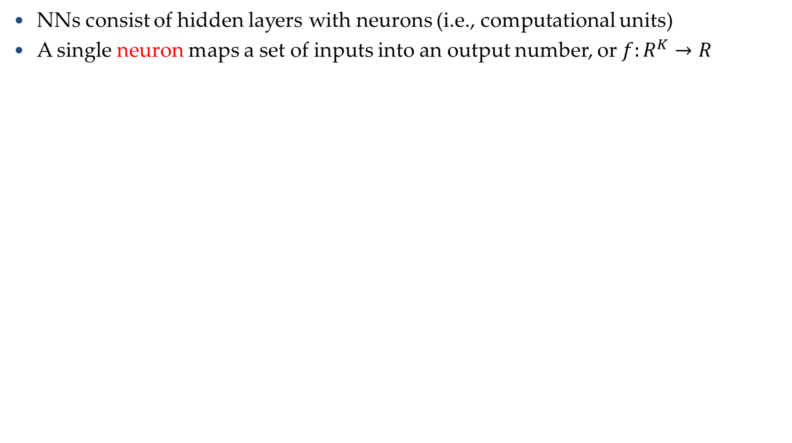
Elements of Neural Networks
Introduction to Neural Networks
NNs consist of hidden layers with neurons (i.e., computational units)
A single neuron maps a set of inputs into an output number, or $f:R^{K}→R$
$$a=σ\left(z\right)$$
…
…
output
Activation function
weights
input
bias
Slide credit: Hung-yi Lee – Deep Learning Tutorial

Slide 34
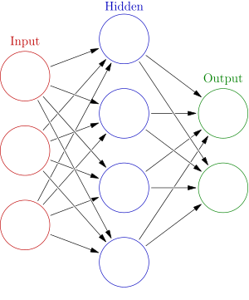
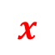


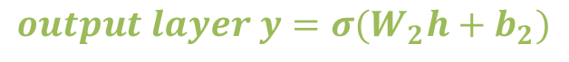
Elements of Neural Networks
Introduction to Neural Networks
A NN with one hidden layer and one output layer
Weights
Biases
$$hidden layer h=σ(W_{1}x+b_{1})$$
$$output layer y=σ(W_{2}h+b_{2})$$
Activation functions
4 + 2 = 6 neurons (not counting inputs)
[3 × 4] + [4 × 2] = 20 weights
4 + 2 = 6 biases
26 learnable parameters
$$y$$
$$x$$
$$h$$
Slide credit: Ismini Lourentzou – Introduction to Deep Learning

Slide 35
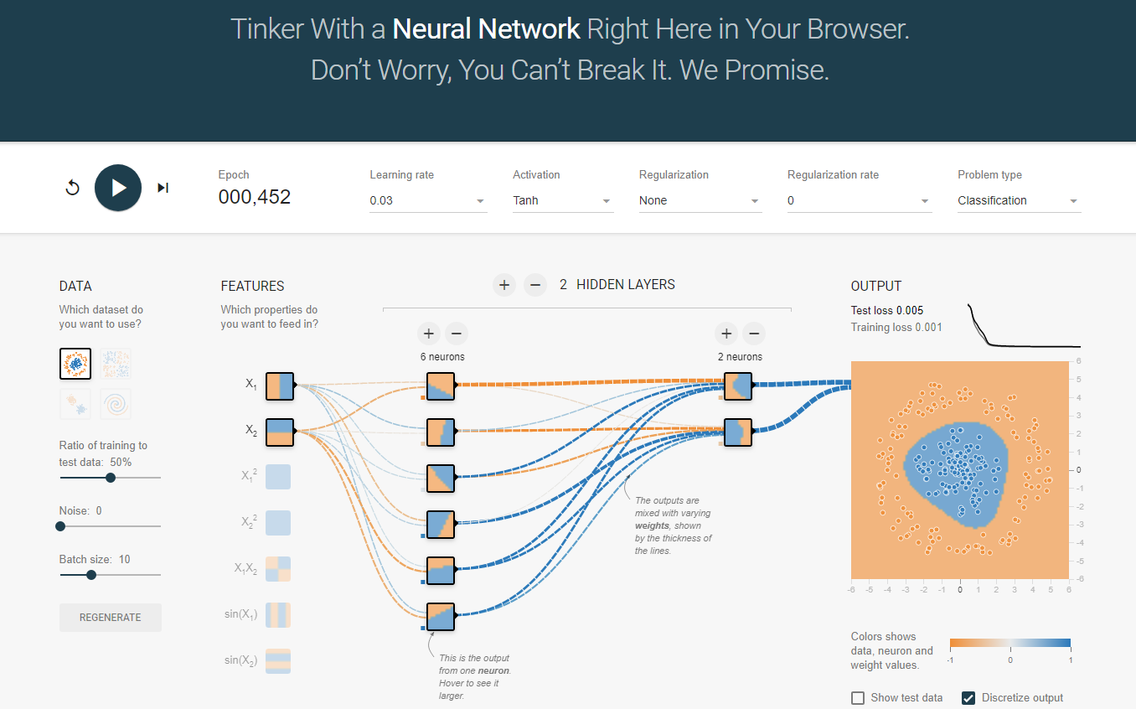
Elements of Neural Networks
Introduction to Neural Networks
A neural network playground link

Slide 36
Elements of Neural Networks
Introduction to Neural Networks
Deep NNs have many hidden layers
Fully-connected (dense) layers (a.k.a. Multi-Layer Perceptron or MLP)
Each neuron is connected to all neurons in the succeeding layer
Input
Layer 1
Layer 2
Layer L
Output
……
y₁
……
y₂
……
……
……
……
……
……
y_{M}
Input Layer
Output Layer
Hidden Layers
Slide credit: Hung-yi Lee – Deep Learning Tutorial

Slide 37
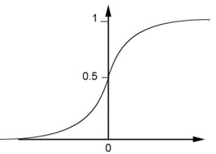
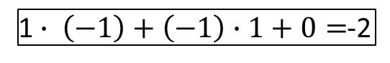
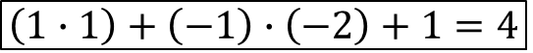
Elements of Neural Networks
Introduction to Neural Networks
A simple network, toy example
$$\left(1∙1\right)+\left(−1\right)∙\left(−2\right)+1=4$$
0.98
Sigmoid Function
1
4
1
-2
1
-1
-2
0.12
-1
1
0
1 $∙ \left(−1\right)+\left(−1\right)∙1+0=$-2
Slide credit: Hung-yi Lee – Deep Learning Tutorial

Slide 38



Elements of Neural Networks
Introduction to Neural Networks
A simple network, toy example (cont’d)
For an input vector ${[\begin{matrix}1 & −1\end{matrix}]}^{T}$, the output is ${[\begin{matrix}0.62 & 0.83\end{matrix}]}^{T}$
1
4
0.98
2
0.86
3
0.62
1
-2
-1
-1
1
0
-2
-1
-2
0.12
-2
0.11
-1
0.83
-1
1
-1
4
0
0
2
$$f\left(\left[\begin{matrix}1 \\ −1\end{matrix}\right]\right)=\left[\begin{matrix}0.62 \\ 0.83\end{matrix}\right]$$
$$f:R^{2}→R^{2}$$
Slide credit: Hung-yi Lee – Deep Learning Tutorial

Slide 39







Matrix Operation
Introduction to Neural Networks
Matrix operations are helpful when working with multidimensional inputs and outputs
1
4
0.98
1
W
x
b
a
+
-2
$σ\left( \right) =$
1
-1
-2
0.12
$$\left[\begin{matrix}1 & −2 \\ −1 & 1\end{matrix}\right]$$
$$\left[\begin{matrix}1 \\ −1\end{matrix}\right]$$
$$\left[\begin{matrix}1 \\ 0\end{matrix}\right]$$
$$=$$
$$\left[\begin{matrix}0.98 \\ 0.12\end{matrix}\right]$$
$$σ\left( \right)$$
$$+$$
-1
1
0
$$\left[\begin{matrix}4 \\ −2\end{matrix}\right]$$
Slide credit: Hung-yi Lee – Deep Learning Tutorial

Slide 40

Matrix Operation
Introduction to Neural Networks
Multilayer NN, matrix calculations for the first layer
Input vector x, weights matrix W¹, bias vector b¹, output vector a¹
……
y₁
W¹
y₂
……
b¹
……
……
……
……
……
x
a¹
……
y_{M}
a¹
W¹
x
b¹
+
$=σ\left( \right)$
Slide credit: Hung-yi Lee – Deep Learning Tutorial

Slide 41



Matrix Operation
Introduction to Neural Networks
Multilayer NN, matrix calculations for all layers
……
y₁
W¹
W²
W^{L}
y₂
……
b¹
b²
b^{L}
……
……
……
……
……
x
a¹
a²
y
……
y_{M}
W¹
x
b¹
+
$$σ\left( \right)$$
W²
a¹
b²
+
$$σ\left( \right)$$
W^{L}
b^{L}
a^{L-1}
+
$$σ\left( \right)$$
Slide credit: Hung-yi Lee – Deep Learning Tutorial

Slide 42



Matrix Operation
Introduction to Neural Networks
Multilayer NN, function f maps inputs x to outputs y, i.e., $y=f(x)$
……
y₁
W¹
W²
W^{L}
y₂
……
b¹
b²
b^{L}
……
……
……
……
……
x
a¹
a²
y
……
y_{M}
y
x
W^{L}
…
W²
W¹
x
b¹
b²
…
b^{L}
$$=f\left( \right)$$
+
+
$$=σ\left( \right)$$
$$σ\left( \right)$$
+
$$σ\left( \right)$$
Slide credit: Hung-yi Lee – Deep Learning Tutorial

Slide 43
Softmax Layer
Introduction to Neural Networks
In multi-class classification tasks, the output layer is typically a softmax layer
I.e., it employs a softmax activation function
If a layer with a sigmoid activation function is used as the output layer instead, the predictions by the NN may not be easy to interpret
Note that an output layer with sigmoid activations can still be used for binary classification
A Layer with Sigmoid Activations
3
0.95
1
0.73
-3
0.05
Slide credit: Hung-yi Lee – Deep Learning Tutorial

Slide 44

Softmax Layer
Introduction to Neural Networks
The softmax layer applies softmax activations to output a probability value in the range [0, 1]
The values z inputted to the softmax layer are referred to as logits
Probability:
$0<y_{i}<1$
$\sum_{i}{y_{i}=1}$
A Softmax Layer
3
20
0.88
1
2.7
0.12
-3
0.05
≈0
Slide credit: Hung-yi Lee – Deep Learning Tutorial

Slide 45


Activation Functions
Introduction to Neural Networks
Non-linear activations are needed to learn complex (non-linear) data representations
Otherwise, NNs would be just a linear function (such as $W_{1}W_{2}x=Wx$)
NNs with large number of layers (and neurons) can approximate more complex functions
Figure: more neurons improve representation (but, may overfit)
Picture from: http://cs231n.github.io/assets/nn1/layer_sizes.jpeg

Slide 46




Activation: Sigmoid
Introduction to Neural Networks
Sigmoid function σ: takes a real-valued number and “squashes” it into the range between 0 and 1
The output can be interpreted as the firing rate of a biological neuron
Not firing = 0; Fully firing = 1
When the neuron’s activation are 0 or 1, sigmoid neurons saturate
Gradients at these regions are almost zero (almost no signal will flow)
Sigmoid activations are less common in modern NNs
$$f\left(x\right)$$
$$ℝ^{n}→\left[0,1\right]$$
$$x$$
Slide credit: Ismini Lourentzou – Introduction to Deep Learning

Slide 47





Activation: Tanh
Introduction to Neural Networks
Tanh function: takes a real-valued number and “squashes” it into range between -1 and 1
Like sigmoid, tanh neurons saturate
Unlike sigmoid, the output is zero-centered
It is therefore preferred than sigmoid
Tanh is a scaled sigmoid: $tanh⁡(x)=2∙σ(2x)−1$
$$f\left(x\right)$$
$$ℝ^{n}→\left[−1,1\right]$$
$$x$$
Slide credit: Ismini Lourentzou – Introduction to Deep Learning

Slide 48





Activation: ReLU
Introduction to Neural Networks
ReLU (Rectified Linear Unit): takes a real-valued number and thresholds it at zero
$f\left(x\right)= max(0,x)$
$$ℝ^{n}→ℝ_{+}^{n}$$
Most modern deep NNs use ReLU activations
ReLU is fast to compute
Compared to sigmoid, tanh
Simply threshold a matrix at zero
Accelerates the convergence of gradient descent
Due to linear, non-saturating form
Prevents the gradient vanishing problem
$$f\left(x\right)$$
$$x$$

Slide 49



Activation: Leaky ReLU
Introduction to Neural Networks
The problem of ReLU activations: they can “die”
ReLU could cause weights to update in a way that the gradients can become zero and the neuron will not activate again on any data
E.g., when a large learning rate is used
Leaky ReLU activation function is a variant of ReLU
Instead of the function being 0 when $x<0$, a leaky ReLU has a small negative slope (e.g., α = 0.01, or similar)
This resolves the dying ReLU problem
Most current works still use ReLU
With a proper setting of the learning rate, the problem of dying ReLU can be avoided
$$f\left(x\right)=\left\{\begin{matrix}\begin{matrix}αx & for x<0 \end{matrix} \\ \begin{matrix}x & for x≫0\end{matrix}\end{matrix}\right.$$

Slide 50



Activation: Linear Function
Introduction to Neural Networks
Linear function means that the output signal is proportional to the input signal to the neuron
$$ℝ^{n}→ℝ^{n}$$
If the value of the constant c is 1, it is also called identity activation function
This activation type is used in regression problems
E.g., the last layer can have linear activation function, in order to output a real number (and not a class membership)
$$f\left(x\right)=cx$$

Slide 51

Training NNs
Training Neural Networks
The network parameters $θ$ include the weight matrices and bias vectors from all layers
Often, the model parameters $θ$ are referred to as weights
Training a model to learn a set of parameters$θ$ that are optimal (according to a criterion) is one of the greatest challenges in ML
$$θ=\left\{W^{1},b^{1},W^{2},b^{2},⋯W^{L},b^{L}\right\}$$
……
y₁
is 1
0.1
……
y₂
0.7
is 2
Softmax
……
……
……
……
y₁₀
is 0
0.2
16 x 16 = 256
Slide credit: Hung-yi Lee – Deep Learning Tutorial

Slide 52

Training NNs
Training Neural Networks
Data preprocessing - helps convergence during training
Mean subtraction, to obtain zero-centered data
Subtract the mean for each individual data dimension (feature)
Normalization
Divide each feature by its standard deviation
To obtain standard deviation of 1 for each data dimension (feature)
Or, scale the data within the range [0,1] or [-1, 1]
E.g., image pixel intensities are divided by 255 to be scaled in the [0,1] range
Picture from: https://cs231n.github.io/neural-networks-2/

Slide 53





Training NNs
Training Neural Networks
To train a NN, set the parameters $θ$ such that for a training subset of images, the corresponding elements in the predicted output have maximum values
Input:
y₁ has the maximum value
Input:
y₂ has the maximum value
.
.
.
Input:
y₉ has the maximum value
Input:
y₁₀ has the maximum value
Slide credit: Hung-yi Lee – Deep Learning Tutorial

Slide 54



Training NNs
Training Neural Networks
Define a loss function/objective function/cost function $ℒ\left(θ\right)$ that calculates the difference (error) between the model prediction and the true label
E.g., $ℒ\left(θ\right)$ can be mean-squared error, cross-entropy, etc.
……
y₁
1
0.2
……
y₂
0
0.3
……
……
……
Cost
……
……
……
……
y₁₀
$$ℒ(θ)$$
0
0.5
True label “1”
Slide credit: Hung-yi Lee – Deep Learning Tutorial

Slide 55











Training NNs
Training Neural Networks
For a training set of $N$ images, calculate the total loss overall all images: $ℒ\left(θ\right)=\sum_{n=1}^{N}{ℒ_{n}\left(θ\right)}$
Find the optimal parameters $θ^{∗}$ that minimize the total loss $ℒ\left(θ\right)$
$$ℒ_{1}\left(θ\right)$$
x¹
NN
y¹
$${\hat{y}}^{1}$$
NN
$$ℒ_{2}\left(θ\right)$$
x²
$${\hat{y}}^{2}$$
y²
NN
$$ℒ_{3}\left(θ\right)$$
x³
$${\hat{y}}^{3}$$
y³
……
……
……
……
NN
$$ℒ_{n}\left(θ\right)$$
x^{N}
$${\hat{y}}^{N}$$
y^{N}
Slide credit: Hung-yi Lee – Deep Learning Tutorial

Slide 56


Loss Functions
Training Neural Networks
Classification tasks
Training
examples
Pairs of 𝑁 inputs $x_{i}$ and ground-truth class labels $y_{i}$
Output
Layer
Softmax Activations
[maps to a probability distribution]
Loss function
$$ℒ\left(θ\right)=−\frac{1}{N}\sum_{i=1}^{N}{\sum_{k=1}^{K}{\left[y_{k}^{(i)}\log{{\hat{y}}_{k}^{(i)}+\left(1−y_{k}^{(i)}\right) }\log\left(1− {\hat{y}}_{k}^{\left(i\right)}\right)\right]}}$$
Cross-entropy
Ground-truth class labels $y_{i}$ and model predicted class labels ${\hat{y}}_{i}$
Slide credit: Ismini Lourentzou – Introduction to Deep Learning

Slide 57


Loss Functions
Training Neural Networks
Regression tasks
Training
examples
Pairs of 𝑁 inputs $x_{i}$ and ground-truth output values$y_{i}$
Output
Layer
Linear (Identity) or Sigmoid Activation
$$ℒ\left(θ\right)= \frac{1}{n}\sum_{i=1}^{n}{{\left(y^{(i)}−{\hat{y}}^{(i)}\right)}^{2}}$$
Mean Squared Error
Loss function
$$ℒ\left(θ\right)= \frac{1}{n}\sum_{i=1}^{n}{\left|y^{(i)}−{\hat{y}}^{(i)}\right|}$$
Mean Absolute Error
Slide credit: Ismini Lourentzou – Introduction to Deep Learning

Slide 58






Training NNs
Training Neural Networks
Optimizing the loss function $ℒ\left(θ\right)$
Almost all DL models these days are trained with a variant of the gradient descent (GD) algorithm
GD applies iterative refinement of the network parameters$θ$
GD uses the opposite direction of the gradient of the loss with respect to the NN parameters (i.e.,$∇ℒ\left(θ\right)=\left[{∂ℒ}/{∂θ_{i}}\right]$ ) for updating $θ$
The gradient of the loss function $∇ℒ\left(θ\right)$ gives the direction of fastest increase of the loss function $ℒ\left(θ\right)$ when the parameters$θ$ are changed
$$ℒ\left(θ\right)$$
$$\frac{∂ℒ}{∂θ_{i}}$$
$$θ_{i}$$

Slide 59








Gradient Descent Algorithm
Training Neural Networks
Steps in the gradient descent algorithm:
Randomly initialize the model parameters$,θ^{0}$
Compute the gradient of the loss function at the initial parameters $θ^{0}$: $∇ℒ\left(θ^{0}\right)$
Update the parameters as: $θ^{new}=θ^{0}−α∇ℒ\left(θ^{0}\right)$
Where α is the learning rate
Go to step 2 and repeat (until a terminating criterion is reached)
Loss $ℒ$
Initial
parameters $θ^{0}$
Gradient $∇ℒ=\frac{∂ℒ}{∂θ}$
Parameter update:${ θ}^{new}=θ−α∇ℒ\left(θ^{0}\right)$
Global loss minimum $ℒ_{min}$
Parameters $θ$

Slide 60













Gradient Descent Algorithm
Training Neural Networks
Example: a NN with only 2 parameters $w_{1}$ and $w_{2}$, i.e., $θ=\left\{w_{1},w_{2}\right\}$
The different colors represent the values of the loss (minimum loss$θ^{∗}$ is ≈ 1.3)
1. Randomly pick a starting point $θ^{0}$
2. Compute the gradient at $θ^{0}$, $∇ℒ\left(θ^{0}\right)$
$$θ^{∗}$$
$$w_{2}$$
3. Times the learning rate $η$, and update $θ,$
$$θ^{new}=θ^{0}−α∇ℒ\left(θ^{0}\right)$$
$$θ^{1}$$
$$θ^{1}=$$
$$θ^{0}−α∇ℒ\left(θ^{0}\right)$$
$$−∇ℒ\left(θ^{0}\right)$$
4. Go to step 2, repeat
$$θ^{0}$$
$$∇ℒ\left(θ^{0}\right)=\left[\begin{matrix}∂ℒ\left(θ^{0}\right)/∂w_{1} \\ ∂ℒ\left(θ^{0}\right)/∂w_{2}\end{matrix}\right]$$
$$w_{1}$$
Slide credit: Hung-yi Lee – Deep Learning Tutorial

Slide 61








Gradient Descent Algorithm
Training Neural Networks
Example (contd.)
Eventually, we would reach a minimum …..
2. Compute the gradient at $θ^{old}$, $∇ℒ\left(θ^{old}\right)$
$$θ^{2}$$
$$θ^{1}−α∇ℒ\left(θ^{1}\right)$$
3. Times the learning rate $η$, and update $θ,$
$$θ^{new}=θ^{old}−α∇ℒ\left(θ^{old}\right)$$
$$w_{2}$$
$$θ^{2}−α∇ℒ\left(θ^{2}\right)$$
$$θ^{1}$$
4. Go to step 2, repeat
$$θ^{0}$$
$$w_{1}$$
Slide credit: Hung-yi Lee – Deep Learning Tutorial

Slide 62




Gradient Descent Algorithm
Training Neural Networks
Gradient descent algorithm stops when a local minimum of the loss surface is reached
GD does not guarantee reaching a global minimum
However, empirical evidence suggests that GD works well for NNs
$ℒ\left(θ\right)$
$$θ$$
Picture from: https://blog.paperspace.com/intro-to-optimization-in-deep-learning-gradient-descent/

Slide 63






Gradient Descent Algorithm
Training Neural Networks
For most tasks, the loss surface $ℒ\left(θ\right)$ is highly complex (and non-convex)
Random initialization in NNs results in different initial parameters $θ^{0}$ every time the NN is trained
Gradient descent may reach different minima at every run
Therefore, NN will produce different predicted outputs
In addition, currently we don’t have algorithms that guarantee reaching a global minimum for an arbitrary loss function
$$ℒ$$
$$w_{1}$$
$$w_{2}$$
Slide credit: Hung-yi Lee – Deep Learning Tutorial

Slide 64


Slide 65

Backpropagation
Training Neural Networks
Modern NNs employ the backpropagation method for calculating the gradients of the loss function $∇ℒ\left(θ\right)={∂ℒ}/{∂θ_{i}}$
Backpropagation is short for “backward propagation”
For training NNs, forward propagation (forward pass) refers to passing the inputs $x$ through the hidden layers to obtain the model outputs (predictions) $y$
The loss $ℒ\left(y,\hat{y}\right)$ function is then calculated
Backpropagation traverses the network in reverse order, from the outputs $y$ backward toward the inputs $x$ to calculate the gradients of the loss$∇ℒ\left(θ\right)$
The chain rule is used for calculating the partial derivatives of the loss function with respect to the parameters$θ$ in the different layers in the network
Each update of the model parameters $θ$ during training takes one forward and one backward pass (e.g., of a batch of inputs)
Automatic calculation of the gradients (automatic differentiation) is available in all current deep learning libraries
It significantly simplifies the implementation of deep learning algorithms, since it obviates deriving the partial derivatives of the loss function by hand

Slide 66

Mini-batch Gradient Descent
Training Neural Networks
It is wasteful to compute the loss over the entire training dataset to perform a single parameter update for large datasets
E.g., ImageNet has 14M images
Therefore, GD (a.k.a. vanilla GD) is almost always replaced with mini-batch GD
Mini-batch gradient descent
Approach:
Compute the loss $ℒ\left(θ\right)$ on a mini-batch of images, update the parameters $θ$, and repeat until all images are used
At the next epoch, shuffle the training data, and repeat the above process
Mini-batch GD results in much faster training
Typical mini-batch size: 32 to 256 images
It works because the gradient from a mini-batch is a good approximation of the gradient from the entire training set

Slide 67

Stochastic Gradient Descent
Training Neural Networks
Stochastic gradient descent
SGD uses mini-batches that consist of a single input example
E.g., one image mini-batch
Although this method is very fast, it may cause significant fluctuations in the loss function
Therefore, it is less commonly used, and mini-batch GD is preferred
In most DL libraries, SGD typically means a mini-batch GD (with an option to add momentum)

Slide 68





Problems with Gradient Descent
Training Neural Networks
Besides the local minima problem, the GD algorithm can be very slow at plateaus, and it can get stuck at saddle points
cost $ℒ\left(θ\right)$
Very slow at the plateau
Stuck at a saddle point
Stuck at a local minimum
$$∇ℒ\left(θ\right)≈0$$
$$∇ℒ\left(θ\right)=0$$
$$∇ℒ\left(θ\right)=0$$
$$θ$$
Slide credit: Hung-yi Lee – Deep Learning Tutorial

Slide 69


Gradient Descent with Momentum
Training Neural Networks
Gradient descent with momentum uses the momentum of the gradient for parameter optimization
cost $ℒ\left(θ\right)$
Movement = Negative of Gradient + Momentum
Negative of Gradient
Momentum
Real Movement
$$θ$$
Gradient = 0
Slide credit: Hung-yi Lee – Deep Learning Tutorial

Slide 70

Gradient Descent with Momentum
Training Neural Networks
Parameters update in GD with momentum at iteration $t$: $θ^{t}=θ^{t−1}−V^{t}$
Where: $V^{t}$= $βV^{t−1}+α∇ℒ\left(θ^{t−1}\right)$
I.e., $θ^{t}=θ^{t−1}−α∇ℒ\left(θ^{t−1}\right)−βV^{t−1}$
Compare to vanilla GD: $θ^{t}=θ^{t−1}−α∇ℒ\left(θ^{t−1}\right)$
Where $θ^{t−1}$ are the parameters from the previous iteration $t−1$
The term $V^{t}$ is called momentum
This term accumulates the gradients from the past several steps, i.e.,
$V^{t}$= $βV^{t−1}+α∇ℒ\left(θ^{t−1}\right)$
$$=β\left(βV^{t−2}+α∇ℒ\left(θ^{t−2}\right)\right)+α∇ℒ\left(θ^{t−1}\right)$$
$$=β^{2}V^{t−2}+βα∇ℒ\left(θ^{t−2}\right)+α∇ℒ\left(θ^{t−1}\right)$$
$$=β^{3}V^{t−3}+β^{2}α∇ℒ\left(θ^{t−3}\right)+βα∇ℒ\left(θ^{t−2}\right)+α∇ℒ\left(θ^{t−1}\right)$$
This term is analogous to a momentum of a heavy ball rolling down the hill
The parameter$β$ is referred to as a coefficient of momentum
A typical value of the parameter $β$ is 0.9
This method updates the parameters $θ$ in the direction of the weighted average of the past gradients

Slide 71


Nesterov Accelerated Momentum
Training Neural Networks
Gradient descent with Nesterov accelerated momentum
Parameter update: $θ^{t}=θ^{t−1}−V^{t}$
Where: $V^{t}$= $βV^{t−1}+α∇ℒ\left(θ^{t−1}+βV^{t−1}\right)$
The term $θ^{t−1}+βV^{t−1}$ allows to predict the position of the parameters in the next step (i.e., $θ^{t} ≈θ^{t−1}+βV^{t−1}$)
The gradient is calculated with respect to the approximate future position of the parameters in the next iteration, $θ^{t}$, calculated at iteration $t−1$
GD with momentum
GD with Nesterov momentum
Picture from: https://towardsdatascience.com/learning-parameters-part-2-a190bef2d12

Slide 72

Adam
Training Neural Networks
Adaptive Moment Estimation (Adam)
Adam combines insights from the momentum optimizers that accumulate the values of past gradients, and it also introduces new terms based on the second moment of the gradient
Similar to GD with momentum, Adam computes a weighted average of past gradients (first moment of the gradient), i.e., $V^{t}$= $β_{1}V^{t−1}+\left(1−β_{1}\right)∇ℒ\left(θ^{t−1}\right)$
Adam also computes a weighted average of past squared gradients (second moment of the gradient), , i.e., $U^{t}$= $β_{2}U^{t−1}+\left(1−β_{2}\right){\left(∇ℒ\left(θ^{t−1}\right)\right)}^{2}$
The parameter update is:$θ^{t}=θ^{t−1}−α\frac{{\hat{V}}^{t}}{\sqrt{{\hat{U}}^{t}}+ε}$
Where: ${\hat{V}}^{t}=\frac{V^{t}}{1−β_{1}}$ and ${\hat{U}}^{t}=\frac{U^{t}}{1−β_{2}}$
The proposed default values are $β_{1}$ = 0.9, $β_{2}$ = 0.999, and $ε={10}^{−8}$
Other commonly used optimization methods include:
Adagrad, Adadelta, RMSprop, Nadam, etc.
Most commonly used optimizers nowadays are Adam and SGD with momentum

Slide 73


Learning Rate
Training Neural Networks
Learning rate
The gradient tells us the direction in which the loss has the steepest rate of increase, but it does not tell us how far along the opposite direction we should step
Choosing the learning rate (also called the step size) is one of the most important hyper-parameter settings for NN training
LR too small
LR too large

Slide 74

Learning Rate
Training Neural Networks
Training loss for different learning rates
High learning rate: the loss increases or plateaus too quickly
Low learning rate: the loss decreases too slowly (takes many epochs to reach a solution)
Picture from: https://cs231n.github.io/neural-networks-3/

Slide 75



Learning Rate Scheduling
Training Neural Networks
Learning rate scheduling is applied to change the values of the learning rate during the training
Annealing is reducing the learning rate over time (a.k.a. learning rate decay)
Approach 1: reduce the learning rate by some factor every few epochs
Typical values: reduce the learning rate by a half every 5 epochs, or divide by 10 every 20 epochs
Approach 2: exponential or cosine decay gradually reduce the learning rate over time
Approach 3: reduce the learning rate by a constant (e.g., by half) whenever the validation loss stops improving
In TensorFlow: tf.keras.callbacks.ReduceLROnPleateau()
Monitor: validation loss, factor: 0.1 (i.e., divide by 10), patience: 10 (how many epochs to wait before applying it), Minimum learning rate: 1e-6 (when to stop)
Warmup is gradually increasing the learning rate initially, and afterward let it cool down until the end of the training
Exponential decay
Cosine decay
Warmup

Slide 76
Vanishing Gradient Problem
Training Neural Networks
In some cases, during training, the gradients can become either very small (vanishing gradients) of very large (exploding gradients)
They result in very small or very large update of the parameters
Solutions: change learning rate, ReLU activations, regularization, LSTM units in RNNs
……
y₁
……
y₂
……
……
……
……
……
……
y_{M}
Small gradients, learns very slow
Slide credit: Hung-yi Lee – Deep Learning Tutorial

Slide 77

Generalization
Generalization
Underfitting
The model is too “simple” to represent all the relevant class characteristics
E.g., model with too few parameters
Produces high error on the training set and high error on the validation set
Overfitting
The model is too “complex” and fits irrelevant characteristics (noise) in the data
E.g., model with too many parameters
Produces low error on the training error and high error on the validation set

Slide 78


Overfitting
Generalization
Overfitting – a model with high capacity fits the noise in the data instead of the underlying relationship
The model may fit the training data very well, but fails to generalize to new examples (test or validation data)
Picture from: http://cs231n.github.io/assets/nn1/layer_sizes.jpeg

Slide 79

Regularization: Weight Decay
Regularization
$ℓ_{2}$ weight decay
A regularization term that penalizes large weights is added to the loss function
$$ℒ_{reg}\left(θ\right)= ℒ\left(θ\right)+λ\sum_{k}{θ_{k}^{2}}$$
For every weight in the network, we add the regularization term to the loss value
During gradient descent parameter update, every weight is decayed linearly toward zero
The weight decay coefficient $λ$determines how dominant the regularization is during the gradient computation
Data loss
Regularization loss

Slide 80


Regularization: Weight Decay
Regularization
Effect of the decay coefficient $λ$
Large weight decay coefficient → penalty for weights with large values

Slide 81

Regularization: Weight Decay
Regularization
$ℓ_{1}$ weight decay
The regularization term is based on the $ℓ_{1}$ norm of the weights
$ℒ_{reg}\left(θ\right)= ℒ\left(θ\right)+λ\sum_{k}{\left|θ_{k}\right|}$
$ℓ_{1}$ weight decay is less common with NN
Often performs worse than $ℓ_{2}$ weight decay
It is also possible to combine $ℓ_{1}$ and $ℓ_{2}$ regularization
Called elastic net regularization
$ℒ_{reg}\left(θ\right)= ℒ\left(θ\right)+λ_{1}\sum_{k}{\left|θ_{k}\right|+λ_{2}\sum_{k}{θ_{k}^{2}}}$

Slide 82

Regularization: Dropout
Regularization
Dropout
Randomly drop units (along with their connections) during training
Each unit is retained with a fixed dropout rate p, independent of other units
The hyper-parameter p needs to be chosen (tuned)
Often, between 20% and 50% of the units are dropped
Slide credit: Hung-yi Lee – Deep Learning Tutorial

Slide 83
Regularization: Dropout
Regularization
Dropout is a kind of ensemble learning
Using one mini-batch to train one network with a slightly different architecture
minibatch
1
minibatch
2
minibatch
3
minibatch
n
……
Slide credit: Hung-yi Lee – Deep Learning Tutorial

Slide 84

Regularization: Early Stopping
Regularization
Early-stopping
During model training, use a validation set
E.g., validation/train ratio of about 25% to 75%
Stop when the validation accuracy (or loss) has not improved after n epochs
The parameter n is called patience
Stop training
validation

Slide 85

Batch Normalization
Regularization
Batch normalization layers act similar to the data preprocessing steps mentioned earlier
They calculate the mean μ and variance σ of a batch of input data, and normalize the data x to a zero mean and unit variance
I.e., $\hat{x}=\frac{x−μ}{σ}$
BatchNorm layers alleviate the problems of proper initialization of the parameters and hyper-parameters
Result in faster convergence training, allow larger learning rates
Reduce the internal covariate shift
BatchNorm layers are inserted immediately after convolutional layers or fully-connected layers, and before activation layers
They are very common with convolutional NNs

Slide 86

Hyper-parameter Tuning
Hyper-parameter Tuning
Training NNs can involve setting many hyper-parameters
The most common hyper-parameters include:
Number of layers, and number of neurons per layer
Initial learning rate
Learning rate decay schedule (e.g., decay constant)
Optimizer type
Other hyper-parameters may include:
Regularization parameters ($ℓ_{2}$ penalty, dropout rate)
Batch size
Activation functions
Loss function
Hyper-parameter tuning can be time-consuming for larger NNs

Slide 87

Hyper-parameter Tuning
Hyper-parameter Tuning
Grid search
Check all values in a range with a step value
Random search
Randomly sample values for the parameter
Often preferred to grid search
Bayesian hyper-parameter optimization
Is an active area of research

Slide 88
k-Fold Cross-Validation
k-Fold Cross-Validation
Using k-fold cross-validation for hyper-parameter tuning is common when the size of the training data is small
It also leads to a better and less noisy estimate of the model performance by averaging the results across several folds
E.g., 5-fold cross-validation (see the figure on the next slide)
Split the train data into 5 equal folds
First use folds 2-5 for training and fold 1 for validation
Repeat by using fold 2 for validation, then fold 3, fold 4, and fold 5
Average the results over the 5 runs (for reporting purposes)
Once the best hyper-parameters are determined, evaluate the model on the test data

Slide 89

k-Fold Cross-Validation
k-Fold Cross-Validation
Illustration of a 5-fold cross-validation
Picture from: https://scikit-learn.org/stable/modules/cross_validation.html

Slide 90
Ensemble Learning
Ensemble Learning
Ensemble learning is training multiple classifiers separately and combining their predictions
Ensemble learning often outperforms individual classifiers
Better results obtained with higher model variety in the ensemble
Bagging (bootstrap aggregating)
Randomly draw subsets from the training set (i.e., bootstrap samples)
Train separate classifiers on each subset of the training set
Perform classification based on the average vote of all classifiers
Boosting
Train a classifier, and apply weights on the training set (apply higher weights on misclassified examples, focus on “hard examples”)
Train new classifier, reweight training set according to prediction error
Repeat
Perform classification based on weighted vote of the classifiers

Slide 91

Deep vs Shallow Networks
Deep vs Shallow Networks
Deeper networks perform better than shallow networks
But only up to some limit: after a certain number of layers, the performance of deeper networks plateaus
output
Shallow NN
Deep
NN
……
……
input
Slide credit: Hung-yi Lee – Deep Learning Tutorial

Slide 92



Convolutional Neural Networks (CNNs)
Convolutional Neural Networks
Convolutional neural networks (CNNs) were primarily designed for image data
CNNs use a convolutional operator for extracting data features
Allows parameter sharing
Efficient to train
Have less parameters than NNs with fully-connected layers
CNNs are robust to spatial translations of objects in images
A convolutional filter slides (i.e., convolves) across the image
Convolutional
3x3 filter
Input matrix
Picture from: http://deeplearning.stanford.edu/wiki/index.php/Feature_extraction_using_convolution

Slide 93


Convolutional Neural Networks (CNNs)
Convolutional Neural Networks
When the convolutional filters are scanned over the image, they capture useful features
E.g., edge detection by convolutions
0 1 0
1 -4 1
0 1 0
Filter
Input Image
Convoluted Image
Slide credit: Param Vir Singh – Deep Learning

Slide 94
Convolutional Neural Networks (CNNs)
Convolutional Neural Networks
In CNNs, hidden units in a layer are only connected to a small region of the layer before it (called local receptive field)
The depth of each feature map corresponds to the number of convolutional filters used at each layer
w1 | w2
w3 | w4
w5 | w6
w7 | w8
Filter 1
Filter 2
Input Image
Layer 1 Feature Map
Layer 2 Feature Map
Slide credit: Param Vir Singh – Deep Learning

Slide 95
Convolutional Neural Networks (CNNs)
Convolutional Neural Networks
Max pooling: reports the maximum output within a rectangular neighborhood
Average pooling: reports the average output of a rectangular neighborhood
Pooling layers reduce the spatial size of the feature maps
Reduce the number of parameters, prevent overfitting
MaxPool with a 2×2 filter with stride of 2
1 | 3 | 5 | 3
4 | 2 | 3 | 1
3 | 1 | 1 | 3
0 | 1 | 0 | 4
4 | 5
3 | 4
Output Matrix
Input Matrix
Slide credit: Param Vir Singh – Deep Learning

Slide 96

Convolutional Neural Networks (CNNs)
Convolutional Neural Networks
Feature extraction architecture
After 2 convolutional layers, a max-pooling layer reduces the size of the feature maps (typically by 2)
A fully convolutional and a softmax layers are added last to perform classification
Living Room
Bedroom
64
64
128
128
256
256
256
512
512
512
512
512
512
Kitchen
Bathroom
Conv layer
Max Pool
Outdoor
Fully Connected Layer
Slide credit: Param Vir Singh – Deep Learning

Slide 97


Residual CNNs
Convolutional Neural Networks
Residual networks (ResNets)
Introduce “identity” skip connections
Layer inputs are propagated and added to the layer output
Mitigate the problem of vanishing gradients during training
Allow training very deep NN (with over 1,000 layers)
Several ResNet variants exist: 18, 34, 50, 101, 152, and 200 layers
Are used as base models of other state-of-the-art NNs
Other similar models: ResNeXT, DenseNet

Slide 98
Recurrent Neural Networks (RNNs)
Recurrent Neural Networks
Recurrent NNs are used for modeling sequential data and data with varying length of inputs and outputs
Videos, text, speech, DNA sequences, human skeletal data
RNNs introduce recurrent connections between the neurons
This allows processing sequential data one element at a time by selectively passing information across a sequence
Memory of the previous inputs is stored in the model’s internal state and affect the model predictions
Can capture correlations in sequential data
RNNs use backpropagation-through-time for training
RNNs are more sensitive to the vanishing gradient problem than CNNs

Slide 99














Recurrent Neural Networks (RNNs)
Recurrent Neural Networks
RNN use same set of weights $w_{h}$ and $w_{x}$ across all time steps
A sequence of hidden states $\left\{h_{o},{h_{o}h}_{2},h_{3}, …\right\}$is learned, which represents the memory of the network
The hidden state at step t, $h\left(t\right)$, is calculated based on the previous hidden state $h\left(t−1\right)$ and the input at the current step $x\left(t\right)$, i.e.,$h\left(t\right)=f_{h}\left(w_{h}∗h\left(t−1\right)+w_{x}∗x\left(t\right)\right)$
The function $f_{h}\left(∙\right)$ is a nonlinear activation function, e.g., ReLU or tanh
RNN shown rolled over time
HIDDEN STATES SEQUENCE: ${h_{o},h}_{1},h_{2},h_{3}, ….$
OUTPUT
$$w_{h}$$
$$w_{h}$$
$$w_{h}$$
$$w_{y}$$
h0
$f_{h}$(·)
h1
$f_{h}$(·)
h2
$f_{h}$(·)
h3
$f_{y}$(·)
$$w_{x}$$
$$w_{x}$$
$$w_{x}$$
x1
x2
x3
INPUT SEQUENCE: $x_{1},x_{2},x_{3}, ….$
Slide credit: Param Vir Singh – Deep Learning

Slide 100


Recurrent Neural Networks (RNNs)
Recurrent Neural Networks
RNNs can have one of many inputs and one of many outputs
RNN
Application
Input
Output
Image Captioning
A person riding a motorbike on dirt road
Sentiment Analysis
Awesome movie. Highly recommended.
Positive
Machine Translation
Happy Diwali
शुभ दीपावली
Slide credit: Param Vir SIngh– Deep Learning

Slide 101




Bidirectional RNNs
Recurrent Neural Networks
Bidirectional RNNs incorporate both forward and backward passes through sequential data
The output may not only depend on the previous elements in the sequence, but also on future elements in the sequence
It resembles two RNNs stacked on top of each other
$${\overset{⃑}{h}}_{t}= σ({\overset{⃑}{W}}^{(hh)}{\overset{⃑}{h}}_{t−1}+{\overset{⃑}{W}}^{(hx)}x_{t})$$
$${\overset{⃖}{h}}_{t}= σ({\overset{⃖}{W}}^{(hh)}{\overset{⃖}{h}}_{t+1}+{\overset{⃖}{W}}^{(hx)}x_{t})$$
$$y_{t}=f\left( \left[{\overset{⃑}{h}}_{t}{;\overset{⃖}{h}}_{t}\right] \right)$$
Outputs both past and future elements
Slide credit: Param Vir Singh – Deep Learning

Slide 102
LSTM Networks
Recurrent Neural Networks
Long Short-Term Memory (LSTM) networks are a variant of RNNs
LSTM mitigates the vanishing/exploding gradient problem
Solution: a Memory Cell, updated at each step in the sequence
Three gates control the flow of information to and from the Memory Cell
Input Gate: protects the current step from irrelevant inputs
Output Gate: prevents current step from passing irrelevant information to later steps
Forget Gate: limits information passed from one cell to the next
Most modern RNN models use either LSTM units or other more advanced types of recurrent units (e.g., GRU units)

Slide 103


LSTM Networks
Recurrent Neural Networks
LSTM cell
Input gate, output gate, forget gate, memory cell
LSTM can learn long-term correlations within data sequences

Slide 104
References
Hung-yi Lee – Deep Learning Tutorial
Ismini Lourentzou – Introduction to Deep Learning
CS231n Convolutional Neural Networks for Visual Recognition (Stanford CS course) (link)
James Hays, Brown – Machine Learning Overview
Param Vir Singh, Shunyuan Zhang, Nikhil Malik – Deep Learning
Sebastian Ruder – An Overview of Gradient Descent Optimization Algorithms (link)

Slide 105


Lecture 3. Fully Connected NN & Hello World of Deep Learning
0–9 handwritten digit recognition:
Neural
Network
“1”
28 x 28
MNIST Data maintained by Yann LeCun: http://yann.lecun.com/exdb/mnist/
Keras provides data sets loading function at http://keras.io/datasets

Slide 106
Keras & Tensorflow
Interface of Tensorflow and Theano.
Francois Chollet, author of Keras is at Google, Keras will become Tensorflow API.
Documentation: http://keras.io.
Examples: https://github.com/fchollet/keras/tree/master/examples
Simple course on Tensorflow: https://docs.google.com/presentation/d/1zkmVGobdPfQgsjIw6gUqJsjB8wvv9uBdT7ZHdaCjZ7Q/edit#slide=id.p

Slide 107

Implementing in Keras
500
500
softmax
y₀
y₁
y₉
28x28
…
Fully connected NN
model = sequential() # layers are sequentially added
model.add( Dense(input_dim=28*28, output_dim=500))
model.add(Activation(‘sigmoid’)) #: softplus, softsign,relu,tanh, hard_sigmoid
model.add(Dense( output_dim = 500))
model.add (Activation(‘sigmoid’))
Model.add(Dense(output_dim=10))
Model.add(Activation(‘softmax’))
model.compile(loss=‘categorical_crossentropy’, optimizer=‘adam’, metrics=[‘accuracy’])
model.fit(x_train, y_train, batch_size=100, nb_epoch=20)

Slide 108


Training
model.fit(x_train, y_train, batch_size=100, nb_epoch=20)
numpy array
28 x 28
=784
10
Number of training examples
Number of training examples

Slide 109
Batch: parallel processing
We do not really minimize total loss!
model.fit(x_train, y_train, batch_size=100, nb_epoch=20)
Randomly initialize network parameters
NN
Pick the 1st batch
x₁
y₁
y’₁
l₁
L’ = l₁ + l₉+ …
Update parameters
First batch
NN
x₉
y₉
y’₉
Pick the 2nd batch
……
l₉
L” = l₂ + l₁₆+ …
Update parameters
NN
…
x₂
y₂
y‘₂
l₂
Until all batches have been picked
2nd batch
x₁₆
NN
y₁₆
y’₁₆
one epoch
……
l₁₆
Repeat the above process

Slide 110

Speed
Very large batch size can yield worse performance
Smaller batch size means more updates in one epoch
E.g. 50000 examples
batch size = 1, 50000 updates in one epoch
batch size = 10, 5000 updates in one epoch
166s
1 epoch
17s
10 epochs
166s
Batch size = 1 and 10, update the same amount of times in the same period.
Batch size = 10 is more stable, converge faster
17s
GTX 980 on MNIST with 50000 training examples

Slide 111



Speed - Matrix Operation
Why is batching faster?
One at a time:
=
=
Batch by GPU, 2 at a time, 1/2 time cost
=
Matrix operation

Slide 112
Keras

Slide 113

Deep learning packages
TensorFlow – Google
PyTorch – Facebook AI research
Keras – Francois Chollet (now at Google)
Chainer – Company in Japan
Caffe - Berkeley Vision and Learning Center
CNTK - Microsoft
https://www.slideshare.net/0xdata/deep‐learning‐with‐mxnet‐dmitry‐larko

Slide 114
Overview of the tutorial
What is Keras ?
Basics of Keras environment
Building Convolutional neural networks
Building Recurrent neural networks
Introduction to other types of layers
Introduction to Loss functions and Optimizers in Keras
Using Pre-trained models in Keras
Saving and loading weights and models
Popular architectures in Deep Learning

Slide 115
What is Keras ?
Deep neural network library in Python
High-level neural networks API
Modular – Building model is just stacking layers and connecting computational graphs
Runs on top of either TensorFlow or Theano or CNTK
Why use Keras ?
Useful for fast prototyping, ignoring the details of implementing backprop or writing optimization procedure
Supports Convolution, Recurrent layer and combination of both.
Runs seamlessly on CPU and GPU
Almost any architecture can be designed using this framework
Open Source code – Large community support

Slide 116

Working principle - Backend
Computational Graphs
Expressing complex expressions as a combination of simple operations
Useful for calculating derivatives during backpropagation
Easier to implement distributed computation
Just specify the inputs, outputs and make sure the graph is connected
e = c*d
where, “c = a+b” and “d = b+1”
So, e = (a+b)*(b+1)
Here “a” ,“b” are inputs
http://colah.github.io/posts/2015‐08‐Backprop/

Slide 117
General pipeline for implementing an ANN
Design and define the neural network architecture
Select the optimizer that performs optimization (gradient descent)
Select the loss function and train it
Select the appropriate evaluation metric for the given problem

Slide 118
Implementing a neural network in Keras
Five major steps
Preparing the input and specify the input dimension (size)
Define the model architecture and build the computational graph
Specify the optimizer and configure the learning process
Specify the Inputs, Outputs of the computational graph (model) and the Loss function
Train and test the model on the dataset
Note: Gradient calculations are taken care by Auto – Differentiation and parameter updates are done automatically in the backend
Define the ANN model
(Sequential or
Functional style)
(MLP, CNN, RNN)
Train and evaluate the model
Prepare Input
(Images, videos,
text, audio)
Optimizers
(SGD, RMSprop, Adam)
Loss function
(MSE, Cross entropy, Hinge)

Slide 119



Procedure to implement an ANN in Keras
Importing Sequential class from keras.models
Stacking layers using .add() method
Configure learning process using .compile() method
Train the model on train dataset using .fit() method

Slide 120


Keras models – Sequential
Sequential model
Linear stack of layers
Useful for building simple models
Simple classification network
Encoder – Decoder models
https://blog.heuritech.com/2016/02/29/a‐brief‐report‐of‐the‐heuritech‐deep‐learning‐meetup‐5/vgg16/
https://www.cc.gatech.edu/~hays/7476/projects/Avery_Wenchen/

Slide 121

Keras models – Functional
Functional Model
Multi – input and Multi – output models
Complex models which forks into 2 or more branches
Models with shared (Weights) layers
https://www.sciencedirect.com/science/article/pii/S0263224117304517
Unsupervised Domain Adaptation by Backpropagation, https://arxiv.org/abs/1409.7495

Slide 122


Keras models – Functional
(Domain Adaption)
Train on Domain A and Test on Domain B
Results in poor performance on test set
The data are from different domains
Solution: Adapt the model to both the domains
Domain A
With Labels
Domain B
Without Labels
https://www.sciencedirect.com/science/article/pii/S0263224117304517
Unsupervised Domain Adaptation by Backpropagation, https://arxiv.org/abs/1409.7495

Slide 123

Convolution neural network - Sequential model
Mini VGG style network
FC – Fully Connected layers (dense layer)
Input dimension – 4D
[N_Train, height, width, channels]
N_train – Number of train samples
Height – height of the image
Width – Width of the image
channels – Number of channels
For RGB image, channels = 3
For gray scale image, channels = 1
Input 4D array
Conv ‐ 32
Conv ‐ 32 Maxpool Conv ‐ 64
Conv ‐ 64 Maxpool FC ‐ 256
FC ‐ 10

Slide 124

Input 4D array
Conv ‐ 32
Conv ‐ 32 Maxpool Conv ‐ 64
Conv ‐ 64 Maxpool FC ‐ 256
FC ‐ 10

Slide 125


Simple MLP network - Functional model
Import class called “Model”
Each layer explicitly returns a tensor
Pass the returned tensor to the next layer as input
Explicitly mention model inputs and outputs

Slide 126

Recurrent Neural Networks
RNNs are used on sequential data – Text, Audio, Genomes etc.
Recurrent networks are of three types
Vanilla RNN
LSTM
GRU
They are feedforward networks with internal feedback
The output at time “t” is dependent on current input and previous values
https://towardsdatascience.com/sentiment‐analysis‐using‐rnns‐lstm‐60871fa6aeba

Slide 127



Recurrent Neural Network
Dense

Slide 128
Convolution layers
1D Conv
keras.layers.convolutional.Conv1D(filters, kernel_size, strides=1, padding='valid', dilation_rate=1, activation=None, use_bias=True, kernel_initializer='glorot_uniform', bias_initializer='zeros', kernel_regularizer=None, bias_regularizer=None, activity_regularizer=None, kernel_constraint=None, bias_constraint=None)
Applications: Audio signal processing, Natural language processing
2D Conv
keras.layers.convolutional.Conv2D(filters, kernel_size, strides=(1, 1), padding='valid', data_format=None, dilation_rate=(1, 1), activation=None, use_bias=True, kernel_initializer='glorot_uniform', bias_initializer='zeros', kernel_regularizer=None, bias_regularizer=None, activity_regularizer=None, kernel_constraint=None, bias_constraint=None)
Applications: Computer vision ‐ Images
3D Conv
keras.layers.convolutional.Conv3D(filters, kernel_size, strides=(1, 1, 1), padding='valid', data_format=None, dilation_rate=(1, 1, 1), activation=None, use_bias=True, kernel_initializer='glorot_uniform', bias_initializer='zeros', kernel_regularizer=None, bias_regularizer=None, activity_regularizer=None, kernel_constraint=None, bias_constraint=None)
Applications: Computer vision – Videos (Convolution along temporal dimension)

Slide 129


Pooling layers
Max pool
keras.layers.pooling.MaxPooling2D(pool_size=(2, 2), strides=None, padding='valid’)
Average pool
keras.layers.pooling.AveragePooling2D(pool_size=(2, 2), strides=None, padding='valid')
Up sampling
keras.layers.convolutional.UpSampling2D(size=(2, 2))
Up sampling

Slide 130
General layers
Dense
keras.layers.core.Dense(units, activation=None, use_bias=True, kernel_initializer='glorot_uniform', bias_initializer='zeros', kernel_regularizer=None, bias_regularizer=None, activity_regularizer=None, kernel_constraint=None, bias_constraint=None)
Dropout
keras.layers.core.Dropout(rate, noise_shape=None, seed=None)
Embedding
keras.layers.embeddings.Embedding(input_dim, output_dim, input_length=None embeddings_initializer='uniform', embeddings_regularizer=None, activity_regularizer=None, embeddings_constraint=None, mask_zero=False)

Slide 131
Optimizers available in Keras
How do we find the “best set of parameters (weights and biases)” for the given network ?
Optimization
They vary in the speed of convergence, ability to avoid getting stuck in local minima
SGD – Stochastic gradient descent
SGD with momentum
Adam
AdaGrad
RMSprop
AdaDelta
Detailed explanation of each optimizer is given in the “Deep learning book”
URL: http://www.deeplearningbook.org/contents/optimization.html

Slide 132


Loss functions available in Keras
MSE – Mean square error
MAE – Mean absolute error
Categorical cross entropy – “K” number of classes
KL divergence – If P(X) and Q(X) are two different probability distributions, then we can measure how different these two distributions are using KL divergence

Slide 133

Loading and Saving Keras models
Use .save method to save the model
Use load_model function to load saved model
Saved file contains –
Architecture of the model
Weights and biases
State of the optimizer
Saving weights
Loading all the weights and loading weights layer wise

Slide 134

Extracting features from pre-trained models
Import the network [eg:VGG16]
Specify the weights
Specify whether the classifier at the top has to be included or not
The argument “include_top = False” – removes the classifier from the imported model
The input size of the image must be same as what the imported model was trained on (with exceptions)

Slide 135
Popular Deep learning Architectures
Popular Convolution networks
Alex net
VGG
Res-Net
DenseNet
Generative models
Autoencoders
Generative adversarial networks

Slide 136


Image recognition networks
AlexNet – 2012
VGG - 2014
AlexNet, https://papers.nips.cc/paper/4824‐imagenet‐classification‐with‐deep‐convolutional‐neural‐networks.pdf
VGG Net, https://arxiv.org/pdf/1409.1556.pdf

Slide 137


Image recognition networks
ResNet – 2015 (residual connections)
DenseNet – 2017 (Dense connectivity)
ResNet, https://arxiv.org/abs/1512.03385
DenseNet, https://arxiv.org/abs/1608.06993

Slide 138

Performance of the recognition networks

Slide 139


Autoencoders
Output
Unsupervised representation learning
Dimensionality reduction
Denoising
Input
https://www.researchgate.net/figure/Figure‐9‐A‐autoencoder‐with‐many‐hidden‐layers‐two‐stacked‐autoencoders_282997080_fig9

Slide 140

Generative Adversarial Network
https://indico.lal.in2p3.fr/event/3487/?view=standard_inline_minutes

Slide 141


Interesting Applications using GANs
Generate images from textual description
Performing arithmetic in latent space
Stack GAN, https://arxiv.org/abs/1612.03242
DC GAN, https://arxiv.org/abs/1511.06434

Slide 142


Interesting Applications using GANs
Generate images of the same scene with different weather conditions
Transfer the style of painting from one image to other
Change the content in the image
UNIT, https://arxiv.org/pdf/1703.00848
Cyclic GAN, https://arxiv.org/abs/1703.10593

Slide 143
Questions ?

